Slide 1


Data and Model-Driven Approaches to Studying Tornado Sheltering and Evacuation Behavior in the Oklahoma City Metropolitan Area
Year 1 Summary Presentation
Dr. Joshua J. Hatzis
Mentor: Dr. Kim Klockow McClain
Behavioral Insights Unit
Peter Lamb Postdoctoral Researcher
September 25, 2020

Slide 2
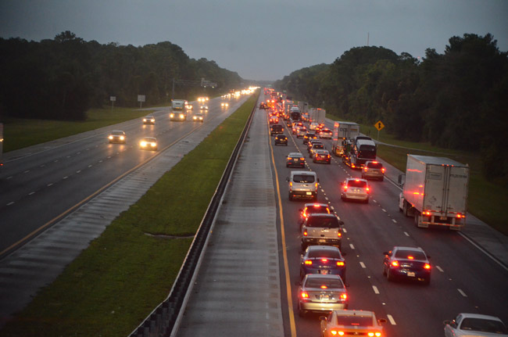
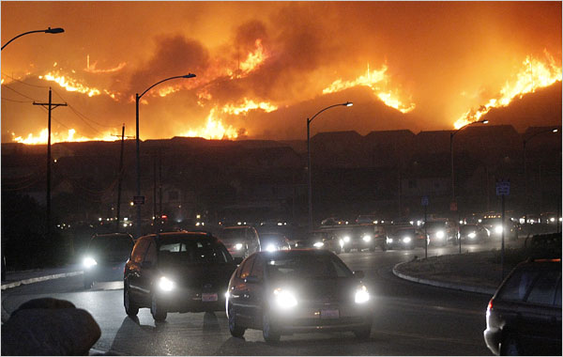
Evacuation
Evacuation is a common safety practice for hazards with a long lead time and/or slow progression (e.g., wildfires, hurricanes) (Beloglazov et al, 2016; Hasan et al, 2011)
For fast moving and sudden hazards like tornadoes, evacuation is rarely recommended (Farley, 2007)
  Only in rural areas with light traffic and significant lead time (Edwards, 2018)
https://flaglerlive.com/100288/florida-evacuations/
https://www.firesafemarin.org/about/news/entry/wildfire-preparedness-week-day-6-go-create-an-evacuation-plan-1

Slide 3
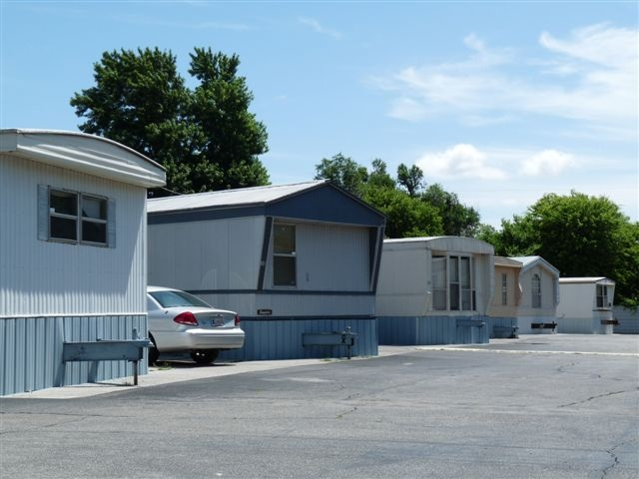
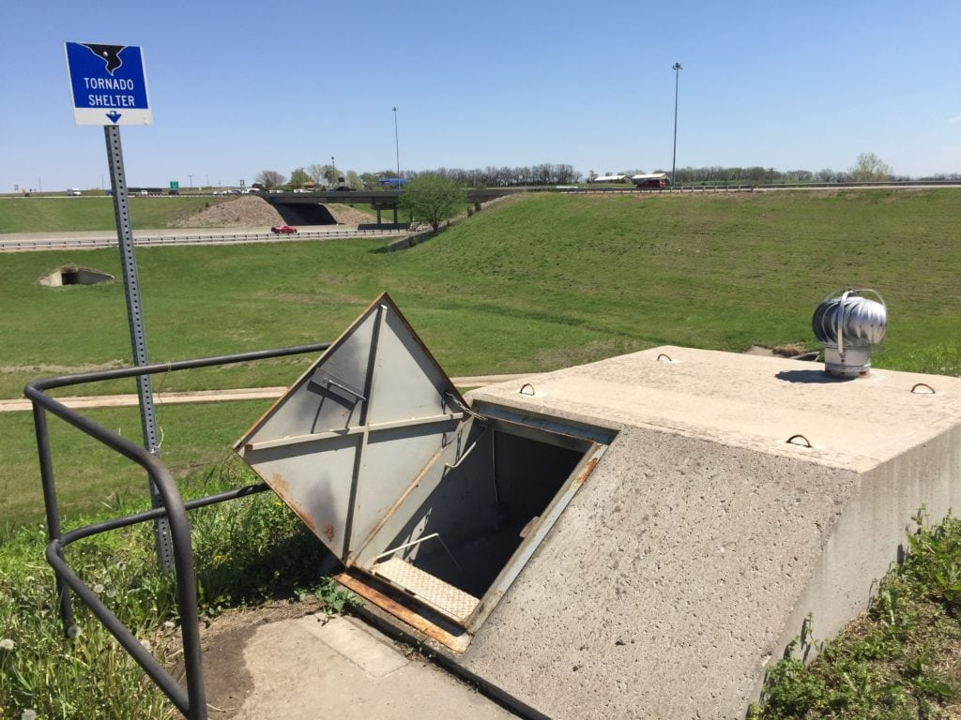
General Recommendations for Tornado Safety
If you are in a sturdy building do not leave (Farley, 2007; Edwards, 2018)
  Go to basement/safe room shelter or interior room/hallway on lowest level
If you are in a mobile home leave and find nearest sturdy building
If you are in a vehicle
  Drive to near nearest sturdy building
  If debris hits vehicle
    Pull over and get as low in vehicle as possible
    Exit vehicle if you can get significantly lower than the road
https://www.apartmenthomeliving.com/apartment-finder/Redcap-Mobile-Home-Park-Oklahoma-City-OK-73107-6083709#gallery
https://www2.ljworld.com/news/2018/may/07/kansas-turnpike-has-tornado-bunkers-some-basements/

Slide 4
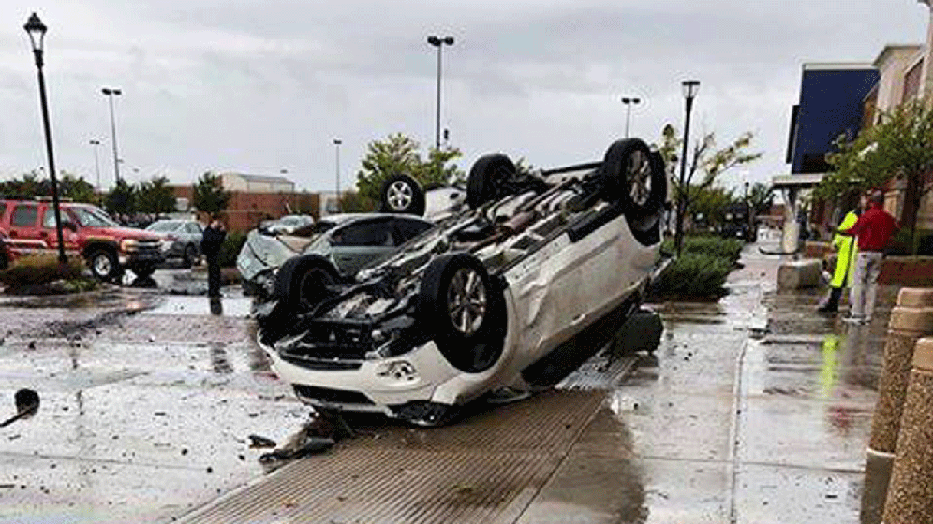
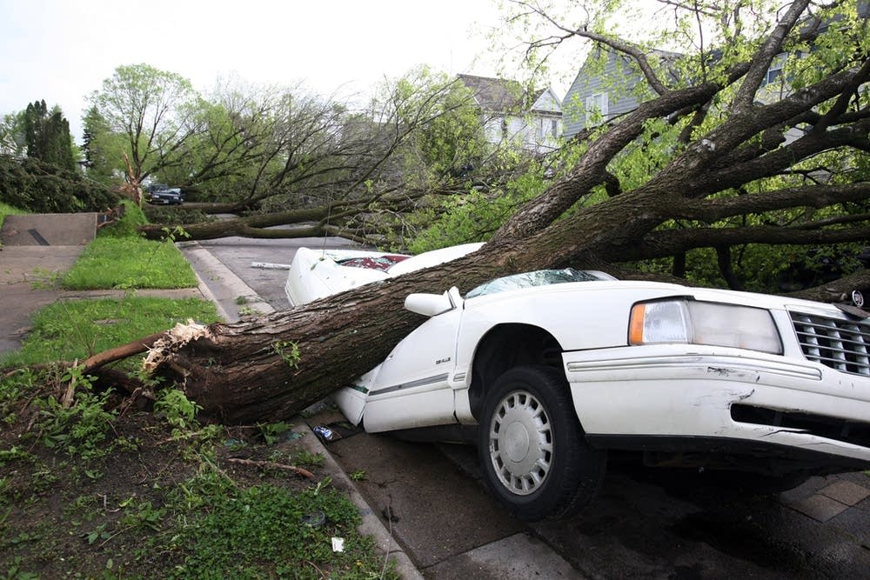
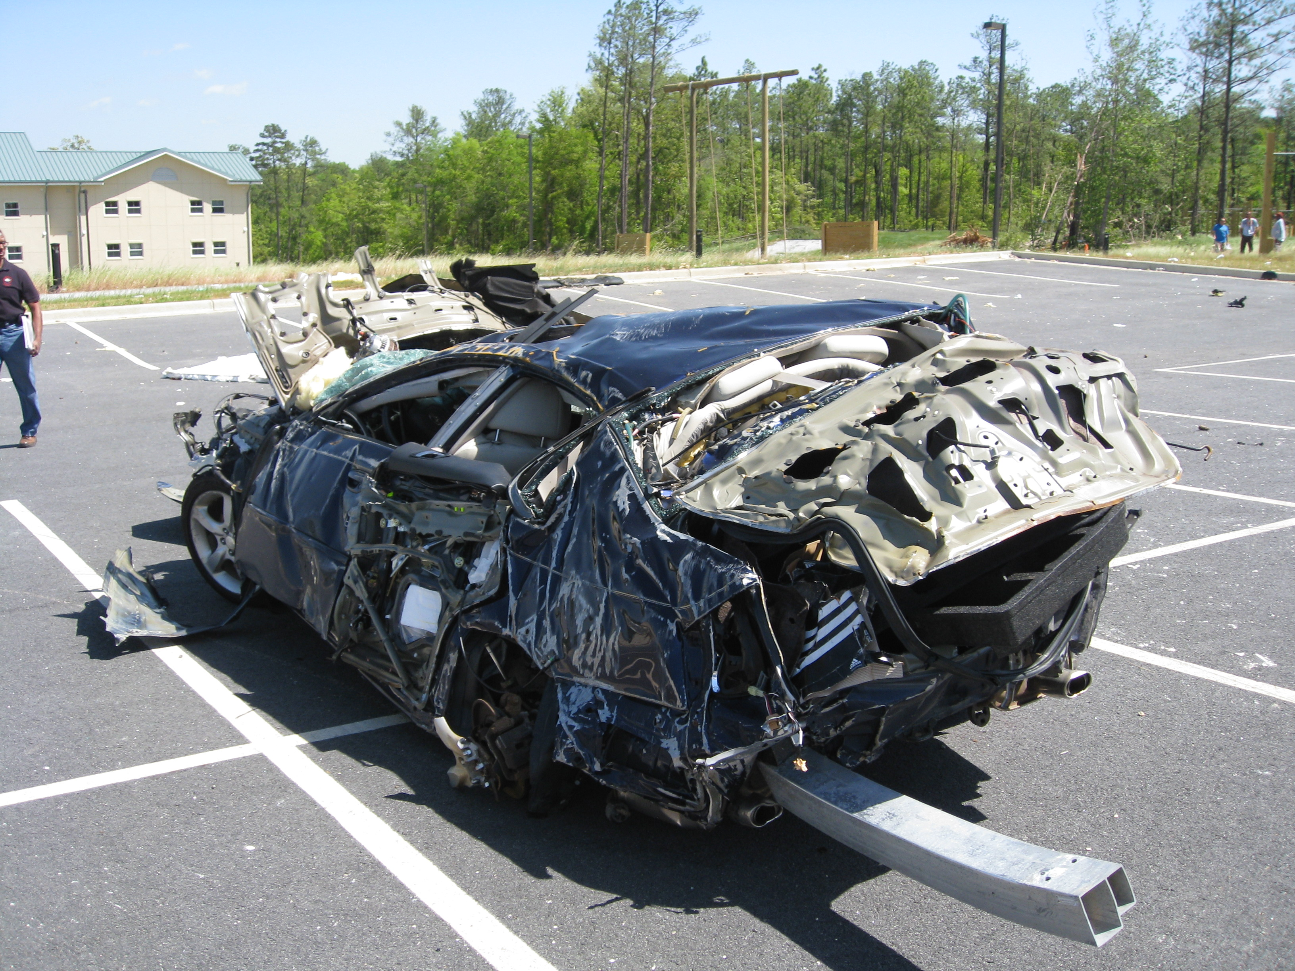
Vehicles and Tornadoes
Vehicle fatalities account for 10-20% of all tornado fatalities (Hammer and Schmidlin, 2002; Ashley, 2007)
  Overall tornado fatalities have decreased while motor vehicle fatalities have increased (Paulikas and Schmidlin, 2017)
Vehicles provide little protection during a tornado
  At EF3 wind speeds vehicles are often lofted (Schmidlin et al., 2002)
  Falling debris can damage a vehicle (Paulikas and Schmidlin, 2017)
Vehicles can allow a person to escape the path of a tornado, however
  New tornadoes can rapidly form
  Tornado paths can suddenly change (Wurman et al., 2014)
  Visible funnel may only be part of the tornado circulation (Wurman et al., 2014)
  Heavy traffic can prevent evacuation (Blaire and Lunde, 2010)
https://www.newson6.com/story/39256490/tornadoes-flip-cars-leave-damage-behind-in-oklahoma
https://www.mprnews.org/story/2011/05/23/tornado-transportation-issues
https://www.weather.gov/ffc/20110415_svrstorms

Slide 5
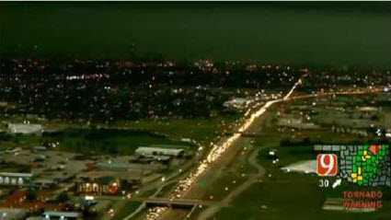
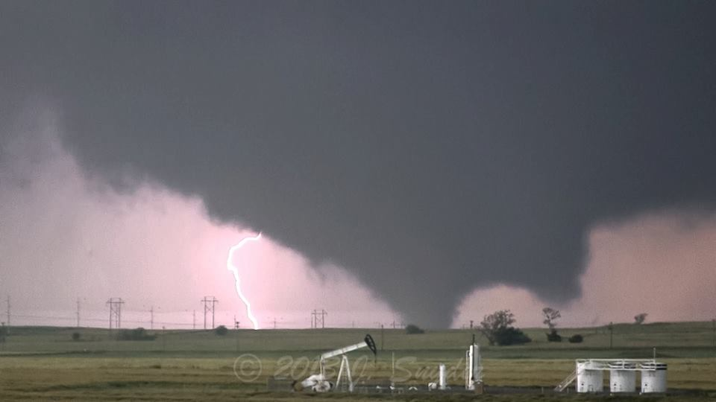
Tornado Evacuation/Sheltering Behavior
Fear based response
  Some people will flee their homes in fear from a particularly violent tornado, especially if encouraged to do so by the media (Uccellini, 2014)
Hypothetical behavior inferred from surveys
  39% of those driving and 18% of those inside would evacuate
    Survey of residents of Austin, TX (Schultz et al., 2010)
  58% of those driving would evacuate while 16.6% of those inside would either evacuate or drive to nearby shelter
    Survey of residents of Calgary, Alberta (Durage et al., 2014)
Past behavior
  31% sought shelter, 73% of those who sought shelter traveled by vehicle
    Survey of mobile home residents in GA, MS, IL and OK (Schmidlin et al., 2009)
http://originalweatherblog.blogspot.com/2013/06/surviving-tornado-below-ground-vs.html
https://www.weather.gov/oun/events-20130531-elreno

Slide 6
Ways to Assess Travel Behavior in Response to Tornado Warnings
Survey data (e.g., Durage et al., 2014; Schultz et al., 2010)
  Only get responses from a subset of the population
  “Behavioral-Intent” surveys have been shown to be inaccurate in predicting actual warning response (Sorensen, 2000)
Traffic volume data (STUDY 1)
Agent based modeling (STUDY 2)

Slide 7
Study 1: Traffic Volume Data Analysis

Slide 8
Research Questions
Is travel behavior influenced by tornado watches and warnings?
  Do changes in behavior occur before or after a warning is issued?
Are mass evacuations due to tornadoes rare?
  Are they more common in some metropolitan areas?
  How do other evacuations compare to the May 31, 2013 event in Oklahoma City

Slide 9
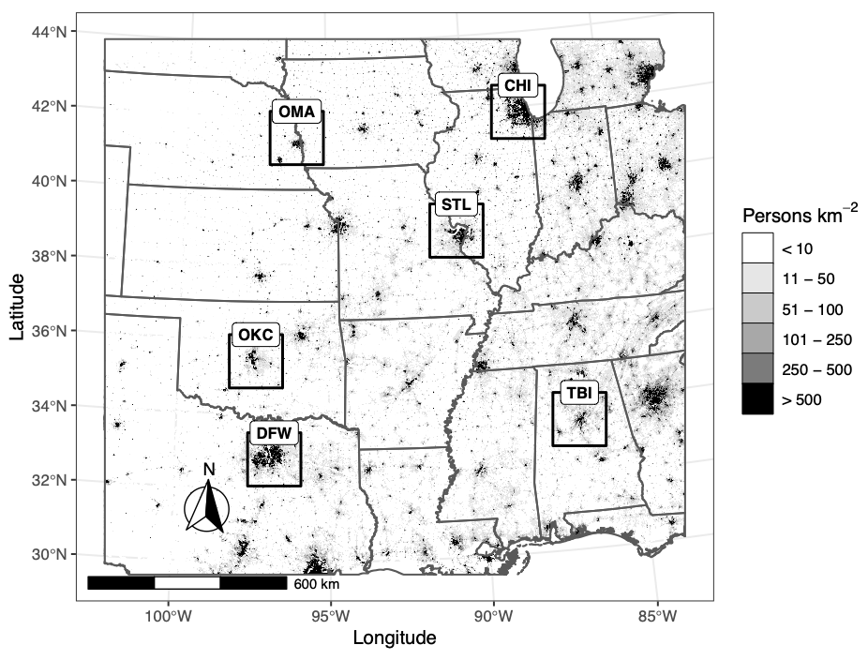
Study Area
Location | Population | Population Density | EF2+ Recurrence | EF4+ Return Period | # Stations
Omaha, NE | 1,193,535 | 46.6 | 1.3 | 10 | 33
Oklahoma City, OK | 1,500,951 | 58.6 | 2.3 | 3.3 | 33
Dallas-Fort Worth, TX | 6,691,936 | 261.4 | 1.3 | 30 | 34
Chicago, IL | 8,875,671 | 346.7 | 0.7 | 30 | 51
St. Louis, MO | 2,759,791 | 107.8 | 1.3 | 30 | 27
Tuscaloosa-Birmingham, AL | 1,647,939 | 64.4 | 2 | 7.5 | 47

Slide 10

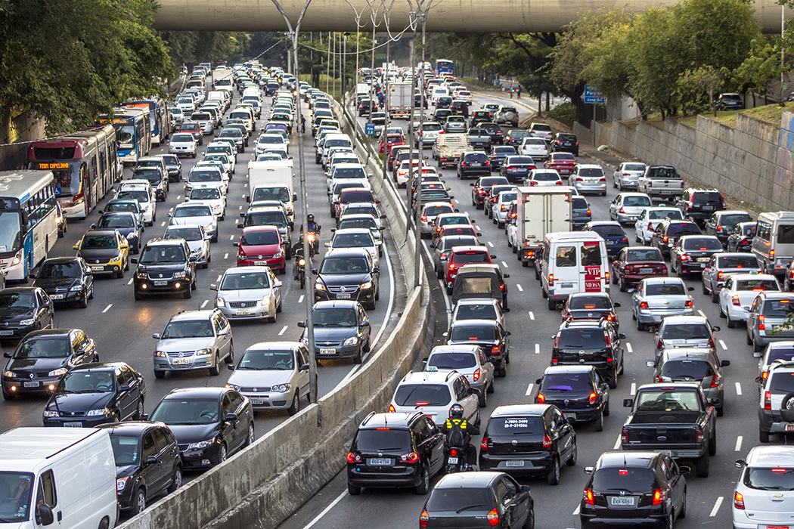
Traffic Volume Data
Traffic volume (vehicles per hour) is measured at count stations throughout the US
  Traffic is detected using various active (e.g., video camera) and passive (e.g., weigh-in-motion) sensors
  Data is collected by State Highway Agencies and quality assured by the Federal Highway Administration (https://www.fhwa.dot.gov/policyinformation/tables/tmasdata/)
  Data is available hourly from 2011 – 2018
Limitations
  Traffic volume data is reported as a flux
    Cannot distinguish between sparse traffic and a traffic jam
  Destinations for traffic is unknown, only thing we know is the direction along the road
  Short period of record
Photo by Bence Balla-Schottner on Unsplash
https://daily.jstor.org/the-science-of-traffic/

Slide 11
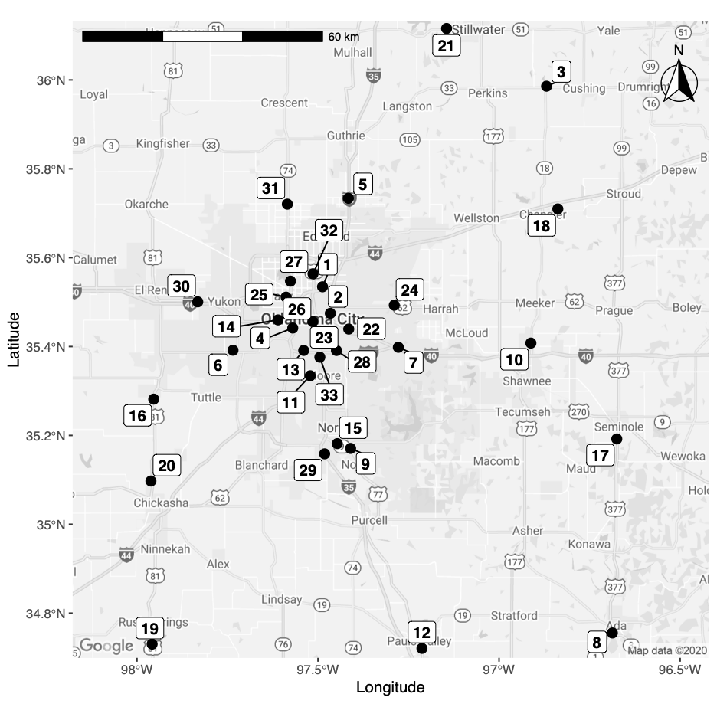
OKC Traffic Stations
# | Site ID | Location |  | # | Site ID | Location
1 | 40AVC026 | On I-44, 0.40 miles E of Kelly Ave, in Oklahoma City |  | 18 | 40AVC047 | On SH-66, 2.40 miles E of SH-18N, E of Chandler
2 | 40AVC056 | On I-35, 0.40 miles S of NE 10th St |  | 19 | 40WIM011 | On US-81, 2.46 miles S of US-81B S, S of Rush Springs
3 | 40AVC040 | On SH-33, 0.50 miles E of SH-18, W of Cushing |  | 20 | 40AVC055 | On US-81, 2.50 miles N of US-62, N of Chickasha
4 | 40AVC023 | On I-44, 0.5 miles N of SW 29th St , in Oklahoma City |  | 21 | 40AVC032 | On SH-51, 3.50 miles E of SH-51C, W of Stillwater
5 | 40WIM104 | On I-35, 0.50 miles N of Waterloo Rd |  | 22 | 40AVC008 | On I-40, 3.80 miles E of I-35, in Midwest City
6 | 40AVC004 | On SH-152, 0.55 miles W of SH-4, in Mustang |  | 23 | 40AVC020 | On I-35, 500 ft S of the Grand Ave (SE 36th St) Bridge
7 | 40AVC067 | On I-40, 0.80 miles E of I-240 |  | 24 | 40AVC005 | On US-62, 9.75 miles E of I-35, in Choctaw
8 | 40WIM009 | On SH-3, 1.10 miles E of SH-1, in Ada |  | 25 | 40AVC006 | On 39th St (SH-66), 1.00 miles W of I-44, in Oklahoma City
9 | 40AVC002 | On US-77, 1.10 miles S of SH-9, in Norman |  | 26 | 40AVC072/3 | On I-40 Crosstown, EB 265 ft W of Shields Blvd OP
10 | 40AVC070 | On SH-18, 1.62 miles N of I-40 |  | 27 | 40AVC065 | On Hefner Pkwy, 0.70 miles N of 63rd St Bridge, OKC
11 | 40AVC001 | On SH-37, 1.70 miles W of I-35, in Moore |  | 28 | 40WIM003 | On I-240, 2.57 miles E of I-35, in Oklahoma City
12 | 40AVC022 | On US-77, 1.74 miles S of SH-19, in Pauls Valley |  | 29 | 40WIM030 | On I-35, 0.47 miles W of SH-74
13 | 40AVC061 | On I-240, 2.00 miles E of I-44, in Oklahoma City |  | 30 | 40WIM028 | On I-40, 300 ft W of Gregory Road
14 | 40AVC007 | On I-40, 2.00 miles W of I-44, in Oklahoma City |  | 31 | 40AVC071 | On SH-74, 0.32 miles S of Waterloo Rd
15 | 40AVC003 | On SH-9, 2.10 miles E of I-35, in Norman |  | 32 | 40AVC024 | On US-77, 0.1 miles S of Britton Rd
16 | 40AVC033 | On US-81, 2.10 miles S of SH-37, S of Minco |  | 33 | 40AVC069 | On I-35, at S end of SE 89th Street Bridge
17 | 40AVC053 | On SH-99, 2.10 miles S of US-270, S of Seminole

Slide 12
Methodology
Calculate the total volume and traffic flow at each station
  E.g., NB Flow = Count_{NB} – Count_{SB}
Calculate summary statistics for volume and flow
  Based on “normal” traffic for the same day of the week in a given month (e.g., mean traffic for a Tuesday in May)
  Holidays and days without weather warnings that would affect road conditions are excluded
Calculate traffic volume and flow anomalies
  E.g., Anomaly = Volume – Mean Volume
Northbound Flow at AVC002 (On US-77, 1.10 miles S of SH-9, in Norman) on May 20, 2013
May 20, 2013 Traffic at AVC002
hour_utc | NB count | SB count | flow | mean | anom
12 | 1052 | 382 | 670 | 714.6 | -44.6
13 | 691 | 333 | 358 | 369.8 | -11.8
14 | 561 | 347 | 214 | 202.4 | 11.6
15 | 528 | 368 | 160 | 141.4 | 18.6
16 | 507 | 449 | 58 | 71.3 | -13.3
17 | 492 | 524 | -32 | -22.1 | -9.9
Northbound flow in OKC on May 20, 2013 at 3 pm

Slide 13
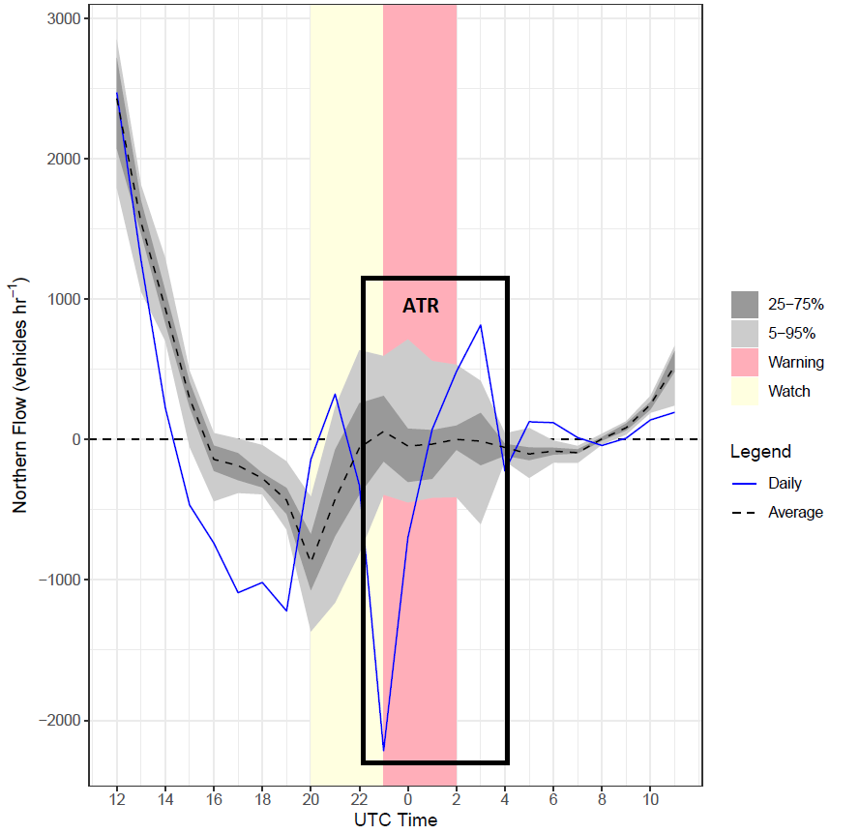
Methodology cont.
Defining an anomalous traffic reversal signature (ATR)
  A traffic anomaly in one direction followed by an anomaly in the opposite direction within 2 hours
    Traffic should return to normal after the anomalous behavior
  Anomalous traffic is considered to be in the top or bottom 5% of the distribution for traffic on a “normal” day of the week
    Values where the flow is between -100 and 100 are considered too close to 0 to indicate an evacuation
An evacuation is assumed to be occurring when 20% of the traffic stations report an ATR
Northbound Flow at AVC020 (On I-35, 500 ft S of the Grand Ave (SE 36th St) Bridge in Oklahoma City) on May 31, 2013

Slide 14
Results

Slide 15
Traffic Behavior and Tornado Alerts
Anomalies in traffic volume are statistically different during tornado watches and warnings
  Based on Kruskal-Wallis test (p=0.05)
Traffic behavior does not appear to change until the warning is issued
  Based on a paired Mann-Whitney test (p=0.05) between the volume during the two hours before and the two hours after the warning
Figure 3. Hourly traffic volume at traffic station 40AVC020 (on I-35, south of the Grand Avenue Bridge in Oklahoma City) for a.) 24 May 2011, b.) 19 May 2013, c.) 20 May 2013, and d.) 31 May 2013. The solid blue line represents the daily traffic volume while the black dashed line represents the average daily traffic for the day of the week and the month matching the specified date (i.e., since 31 May 2013 was a Friday the average would be for all Fridays in the month of May). The light gray shading corresponds to the 5 – 95 percentiles of the traffic volume distribution while the dark grey corresponds to the 25 – 75 percentiles. The yellow and red background sharing refer to the hours where a tornado watch and tornado warning were active, respectively.

Slide 16
Anomalous Traffic Reversals
Location | ATR Days | Evacuation Days
OMA | 16 | 0
OKC | 24 | 3
DFW | 26 | 0
STL | 5 | 0
CHI | 11 | 0
TBI | 18 | 0
Anomalous traffic reversals were found in all metro areas
Only Oklahoma City, Dallas-Fort Worth, and Tuscaloosa-Birmingham had more than 5 ATRs in a day
Only Oklahoma City had 20% of the stations in ATR in a day
Location | Date | # ATR Stations | # Total Stations
OKC | 5/24/2011 | 7 | 33
OKC | 5/19/2013 | 8 | 33
OKC | 5/31/2013 | 14 | 33
DFW | 5/10/2015 | 6 | 34
TBI | 4/27/2011 | 6 | 47
TBI | 12/22/2011 | 6 | 47

Slide 17
Oklahoma City (2011-05-24)

Slide 18
Oklahoma City (2013-05-19)

Slide 19
Oklahoma City (2013-05-31)

Slide 20
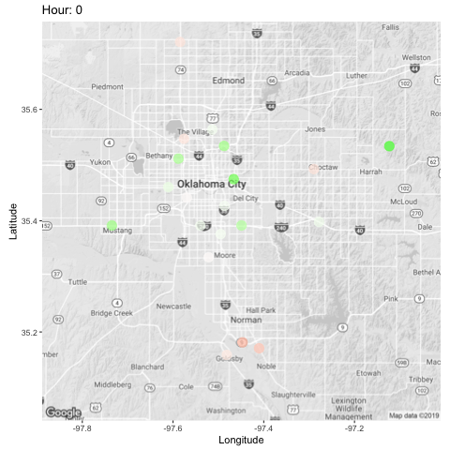
Conclusions
Tornadoes are fast paced hazards which do not generally allow for safe evacuation
Tornado induced evacuations are rare but do occur in major metropolitan areas
  May 31 in OKC was an anomaly
We need to continue to educate the public about the dangers of evacuation during a tornado
  Garfield et al (2014) estimated a worst-case scenario fatality total for the El Reno tornado at 225 fatalities if it had hit closer to the city with such heavy traffic
Possibly suggesting people find a nearby residence they could shelter in if their home isn’t safe

Slide 21
Study 2: Agent Based Model

Slide 22
Agent Based Modeling and Travel Behavior
Agent-based models (ABMs) simulate individual behavior as it is influenced by the environment and other individuals within the system (Grimm et al., 2006).
ABMs have been used in the hazards literature to simulate evacuation behavior during tsunamis (Mas, Suppasri, Imamura, & Koshimura, 2012), hurricanes (Chen, Meaker, & Zhan, 2006), and floods (Liu & Lim, 2016)
Similarly an ABM could be used to assess travel behavior in response to tornado weather information
Such a model could be used to:
  Determine the average time required for all agents to shelter/evacuate
  Estimate simulated casualties based on the position of the agents relative to a simulated tornado and their sheltering status

Slide 23
CHIME ABM Tornado Evacuation Model
Agent Based Model
  Written in NetLogo
Simulates citizen movement (via road networks) in response to a tornado warning
Model is an adaptation of the CHIME ABM (Watts et al., 2019) hurricane evacuation model
  Adjusted for use with tornado hazards
  Physical evacuation component added
    Adapted from Wang et al. (2016)’s Tsunami Evacuation Model
Developed for Norman, Oklahoma

Slide 24
CHIME ABM Hurricane Evacuation Model
Part of a larger study on hazard communication in the modern information environment (Morss et al., 2017)

Slide 25
Tsunami Evacuation Model

Slide 26
Data Sources
Demographics for Norman, Oklahoma (ACS, 2019)
Street center lines (City of Norman, 2020)
  Speed Limits
  Number of Lanes
Traffic signal locations (City of Norman, 2020)
Stop sign locations (City of Norman, 2020)
Building footprints (City of Norman, 2020)
Severe Weather and Society Survey (Ripberger et al., 2020)
  Demographics
  Severe weather warning reception and comprehension
  Protective action plans and past actions
  Trust in weather information sources

Slide 27
Model Simulations
Tornado warning is issued
Citizens collect information about warning
Make protective action decision
If taking protective action, travel to shelter or evacuation point
If not taking protective action, check for an updated forecast later and re-assess

Slide 28
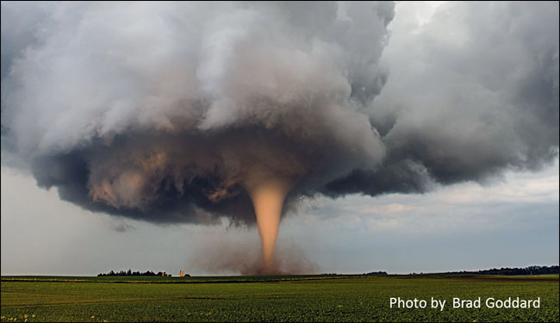
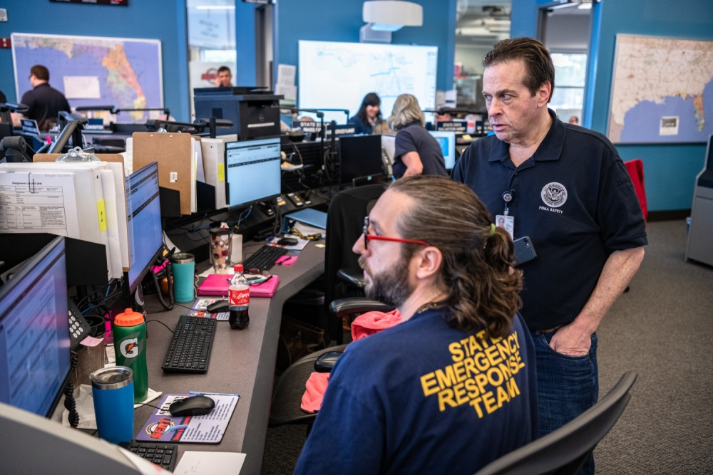

Agent Typology
Storm Agent
  Tasks: Simulated tornado wind field
Forecaster Agents
  Tasks: Read in warnings from NWS
Broadcaster Agents
  Types: TV, Radio, NOAA Weather Radio
  Tasks: Provide weather information to citizens
New Media Agents
  Types: Social Media, Web and Mobile Apps, Mobile Alerts
  Tasks: Provide weather information to citizens
Emergency Managers Agents
  Tasks: Activate sirens
Citizen Agents
  Tasks: Share weather information with other agents & make decisions regarding protective actions
https://www.weather.gov/safety/tornado
https://www.hstoday.us/subject-matter-areas/emergency-preparedness/how-emergency-managers-can-meet-challenges-of-increasingly-complex-threat-climate/
https://wbhm.org/feature/2017/a-tv-meteorologist-like-no-other/

Slide 29
Protective Action Decision Making
Based on Watts et al. (2019)
  Citizen receives warning information from media, sirens, social network, and environmental cues
    Collects information from all available sources based on the location and technology ownership
  Citizen attempts to process and comprehend warning information
    Probability of reception and comprehension based on logistic regression using survey data?
  Citizen decides whether to take protective action
    Assesses risk based on distance from storm and its intensity
    Compares risk to an internal threshold based on their likelihood to take protective action
  If protective action is taken, decide to shelter or evacuate
    Probability of evacuation will be based on the scariness of the messaging
  Travel to chosen destination (evacuation point or shelter choice)

Slide 30
Travel to Shelter/Evacuation Point
Based on Wang et al (2016) Tsunami Evacuation Model
  Select nearest shelter or evacuation point
    All buildings can be used as shelters
    Can set to only FEMA rated shelters
  Travel along road network
  Find route to nearest shelter or evacuation point using A* algorithm
    Route initially will be static
  When traffic is limiting, speeds will be moderated using the General Motors car following model
  Modifications
    Speed limits will vary based on road segments
    Traffic can be multi-lane
    Stop signs and traffic signals will be present at some intersections
    Off-road travel will be by car and not on foot
      Only major roads are included due to high road network density

Slide 31
Next Steps
Submit data-based tornado evacuation study to Weather, Climate and Society
  Present this study at AMS annual conference (Jan 2021)
Develop risk/protective action functions from survey data
Build model
  Combine and adapt NetLogo code from Watts et al. (2019) and Wang et al. (2016)
Conduct Experiments
  Moderate initial traffic levels
  Everyone evacuates
  Everyone shelters
Present completed model at AAG annual conference (Apr 2021)

Slide 32
Questions?
Dr. Joshua Hatzis
E-mail: jjhatzis@ou.edu

Slide 33
References
Ashley, W. S. (2007). Spatial and temporal analysis of tornado fatalities in the United States: 1880–2005. Weather and Forecasting, 22(6), 1214–1228. https://doi.org/10.1175/2007waf2007004.1
Beloglazov, A., Almashor, M., Abebe, E., Richter, J., & Steer, K. C. B. (2016). Simulation of wildfire evacuation with dynamic factors and model composition. Simulation Modelling Practice and Theory, 60, 144–159.
Blair, S. F., & Lunde, E. P. K. (2010). Tornadoes impacting interstates: Service and societal considerations. E-Journal of Severe Storms Meteorology, 5(4).
Chen, X., Meaker, J. W., & Zhan, F. B. (2006). Agent-based modeling and analysis of hurricane evacuation procedures for the Florida Keys. Natural Hazards, 38(3), 321.
Durage, S. W., Kattan, L., Wirasinghe, S. C., & Ruwanpura, J. Y. (2014). Evacuation behaviour of households and drivers during a tornado: Analysis based on a stated preference survey in Calgary, Canada. Natural Hazards, 71(3), 1495–1517. https://doi.org/10.1007/s11069-013-0958-6
Edwards, R. (2018). The online tornado faq. National Weather Service. National Oceanic and Atmospheric Administration. https://www.spc.noaa.gov/faq/tornado/
Farley, J. E. (2007). Call-to-action statements in tornado warnings: Do they reflect recent developments in tornado-safety research? International Journal of Mass Emergencies and Disasters, 25(1), 1–36.
Garfield, G., & Smith, R. (2014). Sheltering Behavior During 2 Major Tornado Events : Is More “Lead Time” Better?
Grimm, V., Berger, U., Bastiansen, F., Eliassen, S., Ginot, V., Giske, J., Goss-Custard, J., Grand, T., Heinz, S. K., Huse, G., & others. (2006). A standard protocol for describing individual-based and agent-based models. Ecological Modelling, 198(1–2), 115–126.
Hammer, B., & Schmidlin, T. W. (2002). Response to warnings during the 3 May 1999 Oklahoma City tornado: Reasons and relative injury rates. Weather and Forecasting, 17(3), 577–581. https://doi.org/10.1175/1520-0434(2002)017<0577:RTWDTM>2.0.CO;2
Hasan, S., Ukkusuri, S., Gladwin, H., & Murray-Tuite, P. (2011). Behavioral model to understand household-level hurricane evacuation decision making. Journal of Transportation Engineering, 137(5), 341–348.
Liu, X., & Lim, S. (2016). Integration of spatial analysis and an agent-based model into evacuation management for shelter assignment and routing. Journal of Spatial Science, 61(2), 283–298.
Mas, E., Suppasri, A., Imamura, F., & Koshimura, S. (2012). Agent-based simulation of the 2011 great east japan earthquake/tsunami evacuation: An integrated model of tsunami inundation and evacuation. Journal of Natural Disaster Science, 34(1), 41–57.
Morss, R. E., Demuth, J. L., Lazrus, H., Palen, L., Barton, C. M., Davis, C. A., Snyder, C., Wilhelmi, O. V, Anderson, K. M., Ahijevych, D. A., & others. (2017). Hazardous weather prediction and communication in the modern information environment. Bulletin of the American Meteorological Society, 98(12), 2653–2674.

Slide 34
References cont.
Paulikas, M. J., & Schmidlin, T. W. (2017). US tornado fatalities in motor vehicles (1991--2015). Natural Hazards, 87(1), 121–143.
Ripberger, J., Silva, C., & Jenkins-Smith, H. (2020a). WX17. Harvard Dataverse. https://doi.org/10.7910/DVN/GSTYK4
Ripberger, J., Silva, C., & Jenkins-Smith, H. (2020b). WX18. Harvard Dataverse. https://doi.org/10.7910/DVN/RHT4ON
Ripberger, J., Silva, C., & Jenkins-Smith, H. (2020c). WX19. Harvard Dataverse. https://doi.org/10.7910/DVN/MLCJEW
Schmidlin, T., Hammer, B., King, P., Ono, Y., Miller, L. S., & Thumann, G. (2002). Unsafe at any (wind) speed? Testing the stability of motor vehicles in severe winds. Bulletin of the American Meteorological Society, 83(12), 1821–1830.
Schmidlin, T. W., Hammer, B. O., Ono, Y., & King, P. S. (2009). Tornado shelter-seeking behavior and tornado shelter options among mobile home residents in the United States. Natural Hazards, 48(2), 191–201. https://doi.org/10.1007/s11069-008-9257-z
Schultz, D. M., Gruntfest, E. C., Hayden, M. H., Benight, C. C., Drobot, S., & Barnes, L. R. (2010). Decision making by Austin, Texas, residents in hypothetical tornado scenarios. Weather, Climate, and Society, 2(3), 249–254. https://doi.org/10.1175/2010WCAS1067.1
Sorensen, J. H. (2000). Hazard warning systems: Review of 20 years of progress. Natural Hazards Review, 1(2), 119–125.
Uccellini, L. W. (2014). May 2013 Oklahoma Tornadoes and Flash Flooding National Oceanic and Atmospheric Administration. March, 63.
Wang, H., Mostafizi, A., Cramer, L. A., Cox, D., & Park, H. (2016). An agent-based model of a multimodal near-field tsunami evacuation: Decision-making and life safety. Transportation Research Part C: Emerging Technologies, 64, 86–100.
Watts, J., Morss, R. E., Barton, C. M., & Demuth, J. L. (2019). Conceptualizing and implementing an agent-based model of information flow and decision making during hurricane threats. Environmental Modelling & Software, 122, 104524.
Wurman, J., Kosiba, K., Robinson, P., & Marshall, T. (2014). The role of multiple-vortex tornado structure in causing storm researcher fatalities. Bulletin of the American Meteorological Society, 95(1), 31–45. https://doi.org/10.1175/BAMS-D-13-00221.1

